Slide 1
Applied Deep Learning
Module 5:
Chapter 10
Notes:
These are notes for the slide

Slide 2
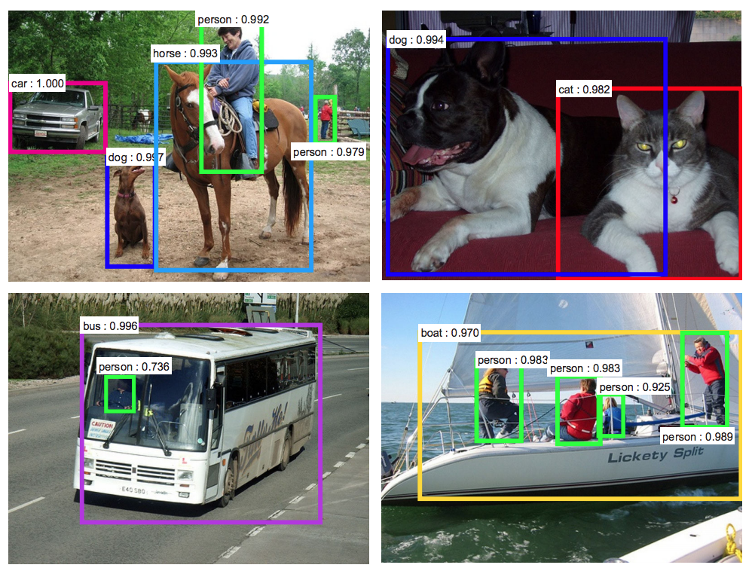
Chapter 10
Machine Vision

Slide 3
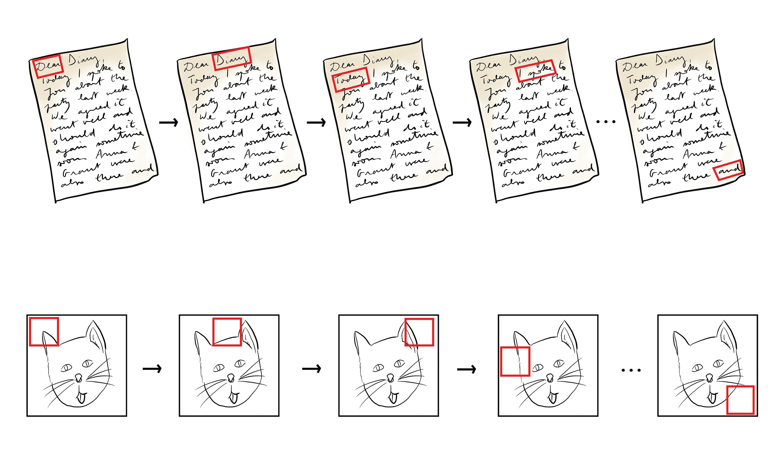
The Convolutional Operation
Notes:
- Convolutional layers consist of sets of kernels (filters).

Slide 4
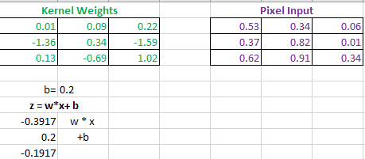
Convolutional Filter Math

Slide 5
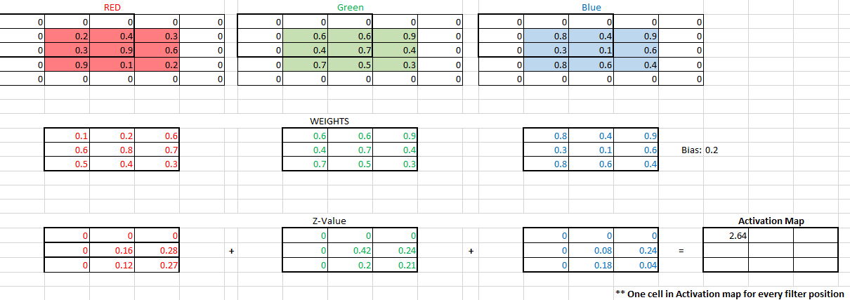
Convolutional Example – One Filter
Notes:
Figure 10.3

Slide 6
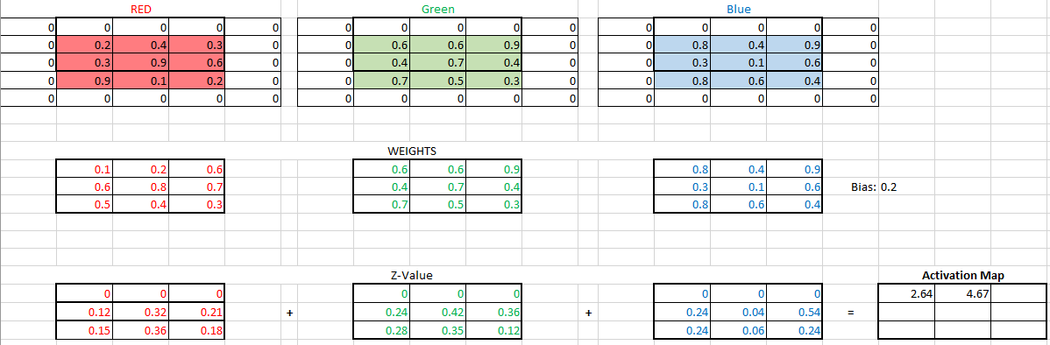
Convolutional Example – One Filter (2)
Notes:
Figure 10.4

Slide 7
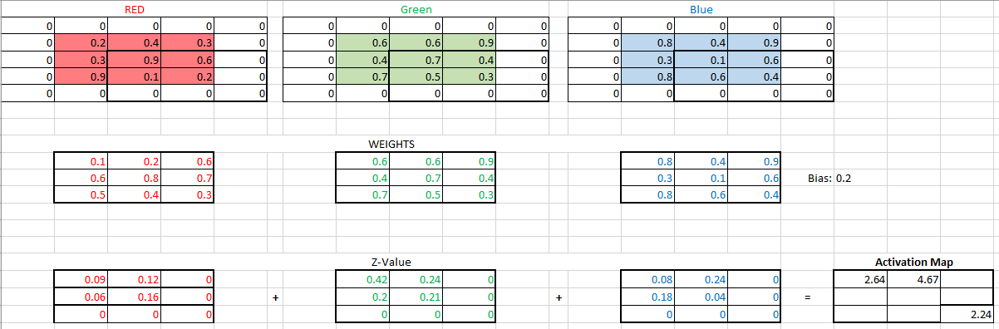
Convolutional Example – One Filter (3)
Notes:
Figure 10.5

Slide 8
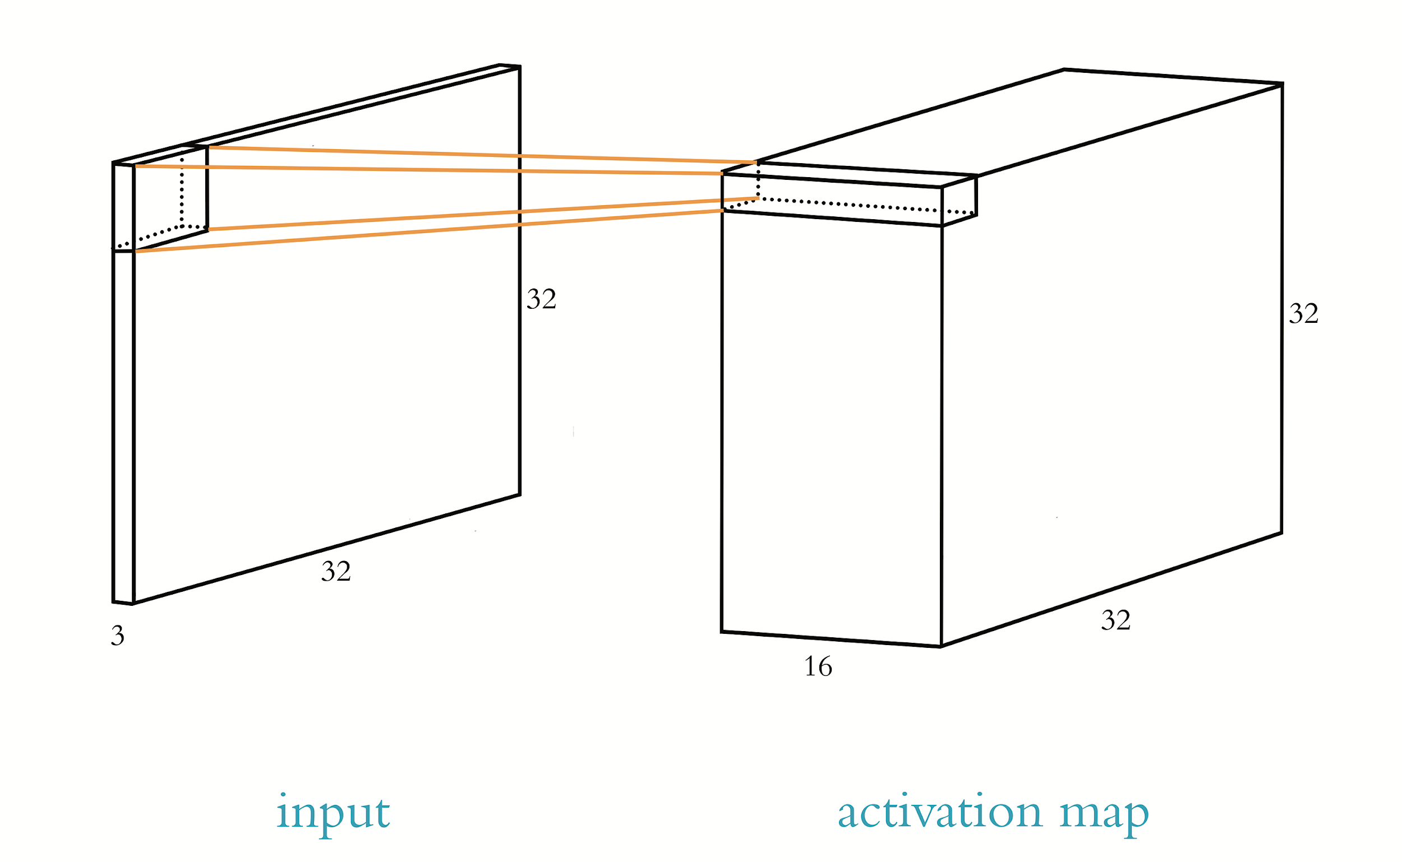

Slide 9
Convolutional Filter Hyperparameters
Kernel size
Common to use 3 X 3 or 5 X 5
Too large → too many competing features
Too small → unable to tune to structures
Stride length
Size of step kernel takes moving over the image
Strides of 1 or 2 pixels are common
Padding
Keeps calculations of convolutional layer in order

Slide 10
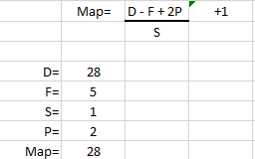
Activation Map

Slide 11
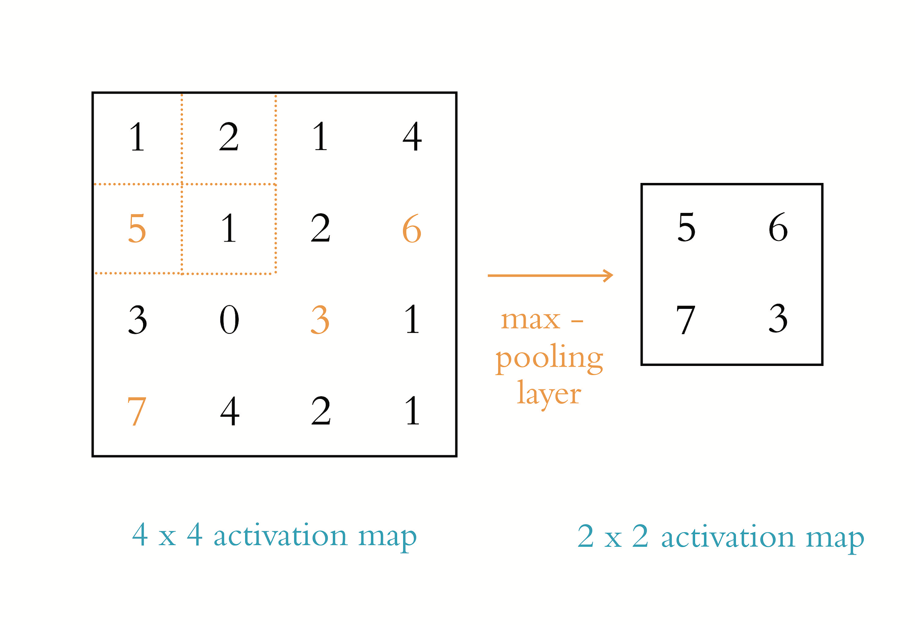
Max-Pooling

Slide 12
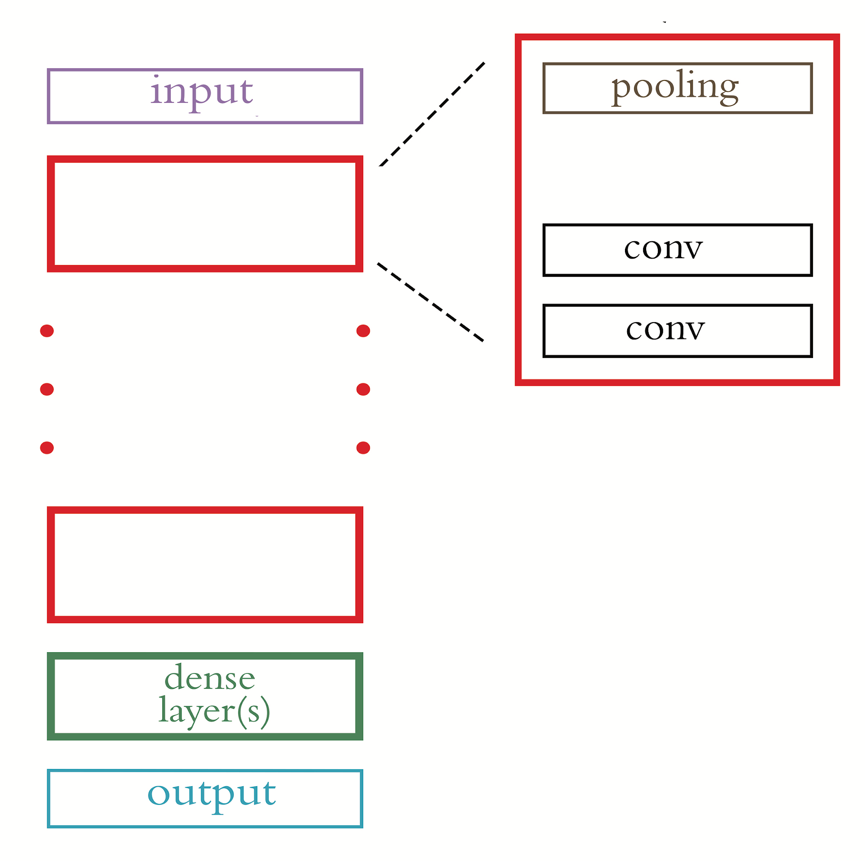
Conv-Pool Blocks for CNNs

Slide 13
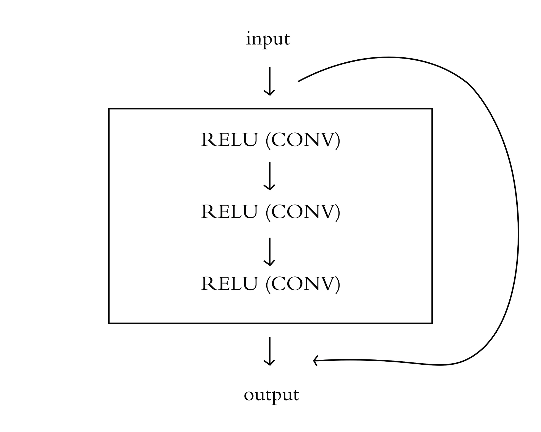
A Residual Module

Slide 14
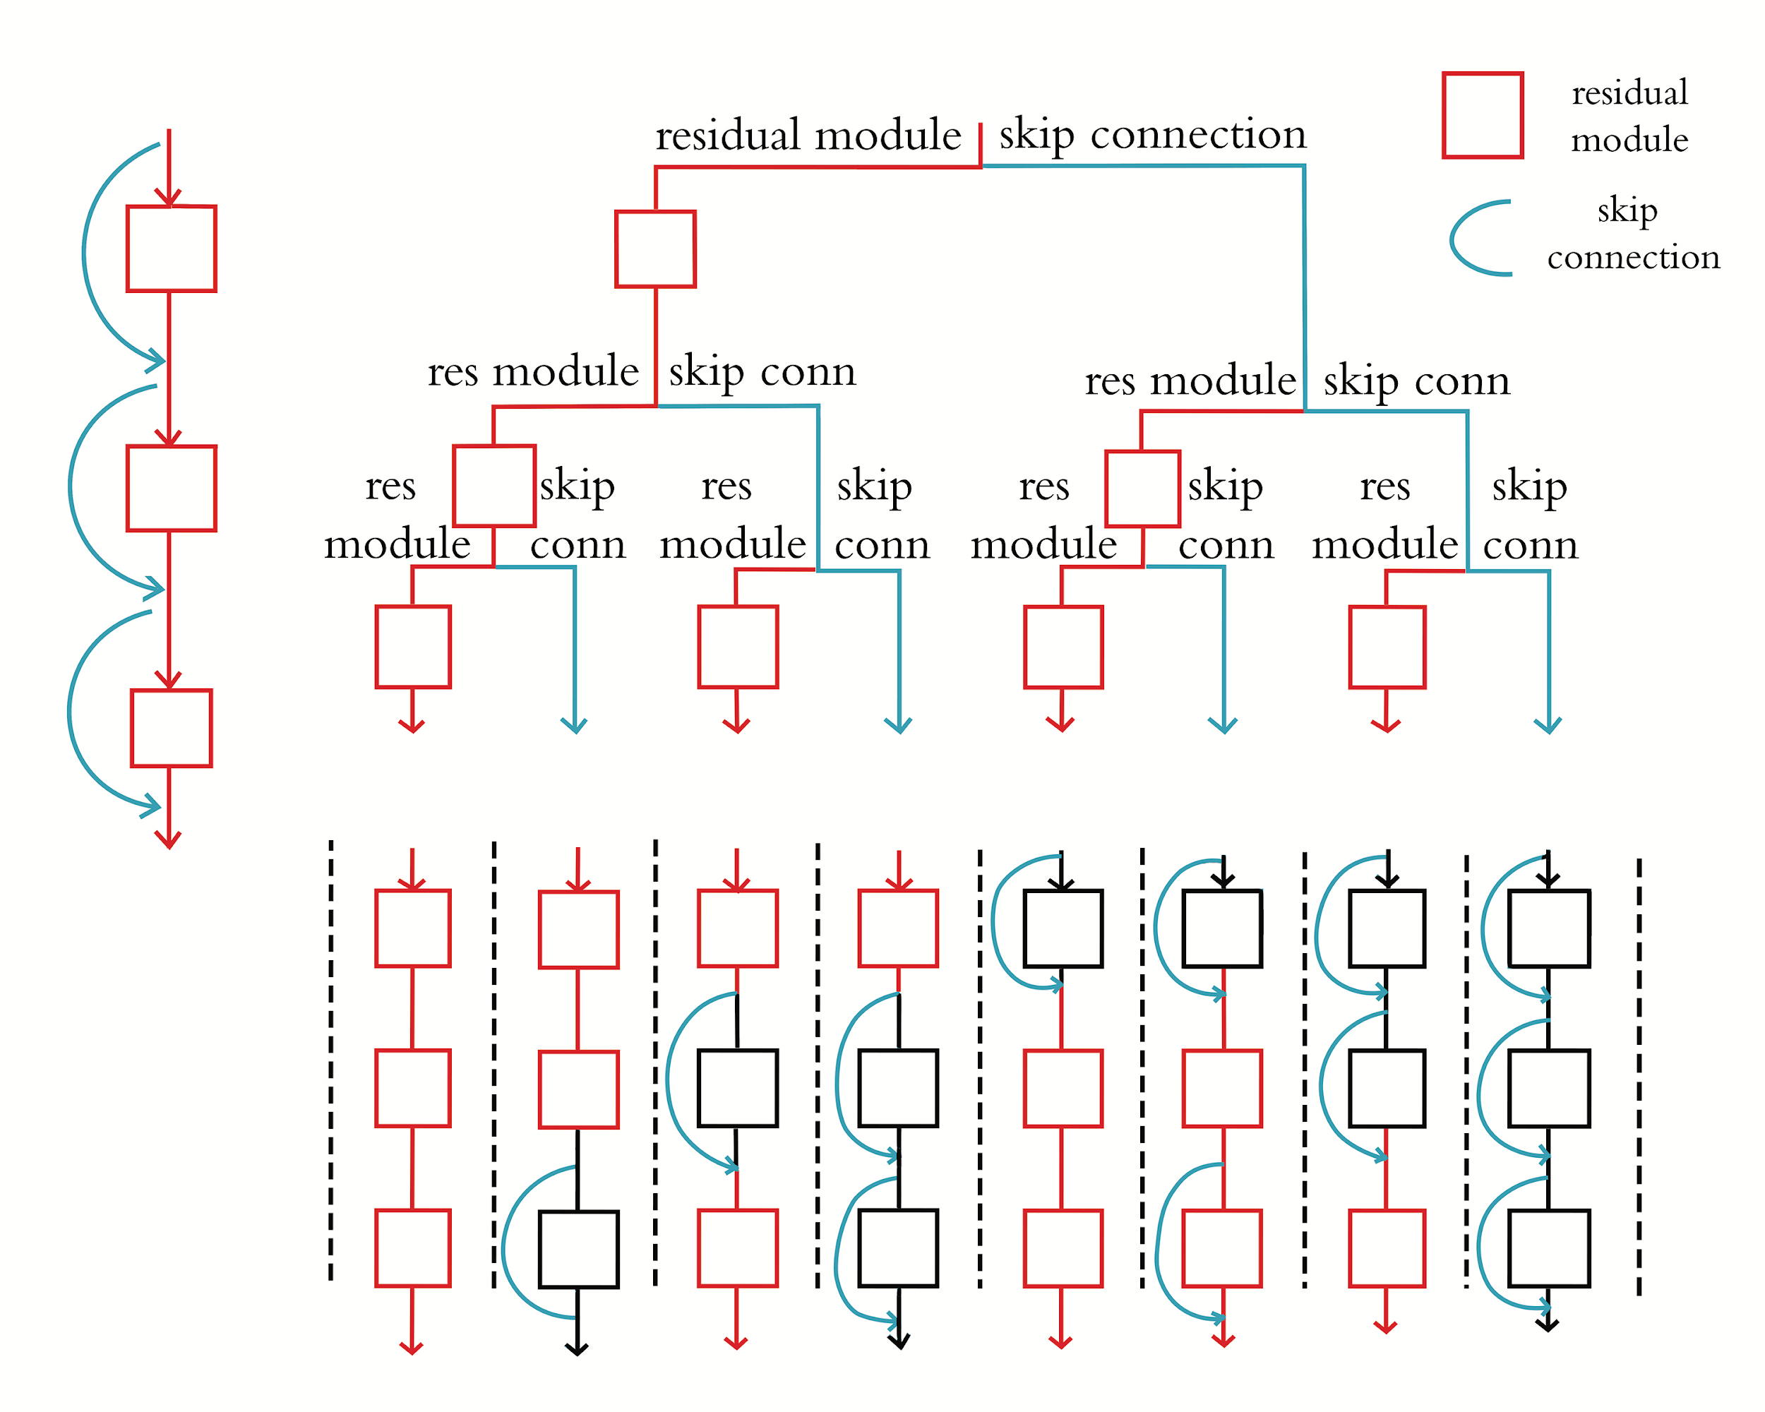

Slide 15
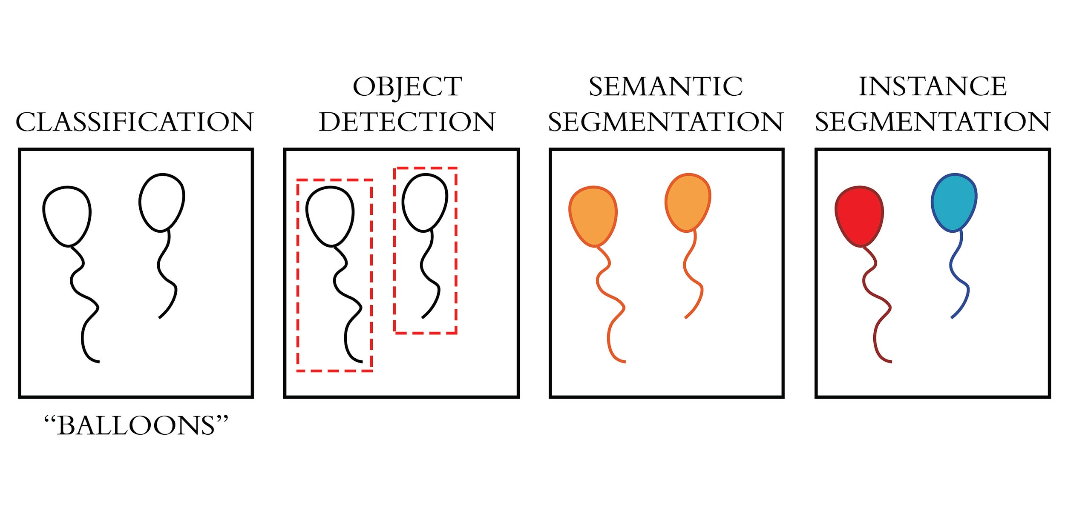
Machine Vision Applications

Slide 16
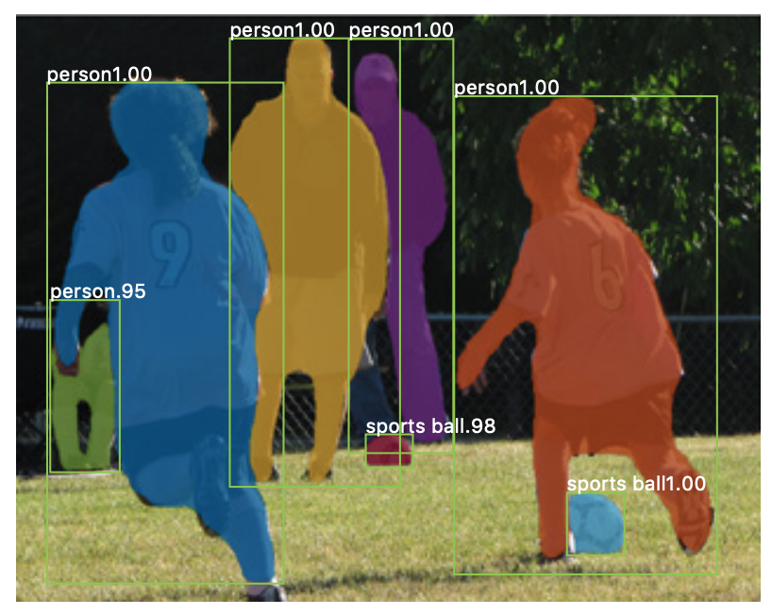
Image Segmentation
He, K. et al. (2017). arXiv: 1703.06870

Slide 17
Seminal Image Segmentation Algos
Mask R-CNN
U-Net

Slide 18
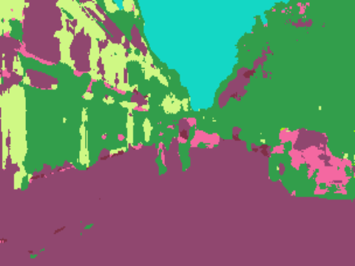
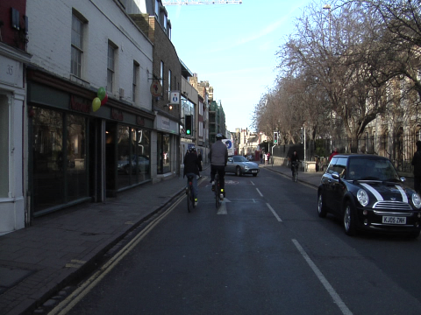
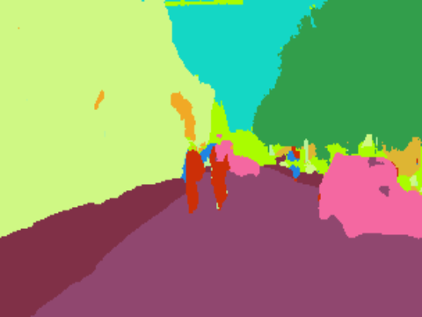
VGGNet U-Net Results
1 Epoch
Test Image
9 Epochs

Slide 19
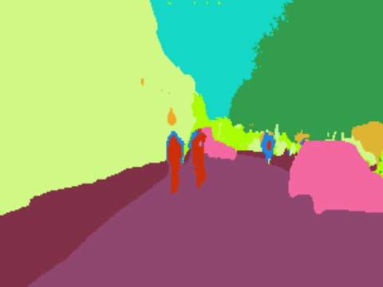
ResNet U-Net Result
VGGNet (9 Epochs)
Test Image
ResNet (4 Epochs)

Slide 20
Object Detection
Ren, S. et al. (2015). arXiv: 1506.01497

Slide 21
Seminal Object Detection Algorithms
R-CNN
Fast R-CNN
Faster R-CNN
YOLO

Slide 22
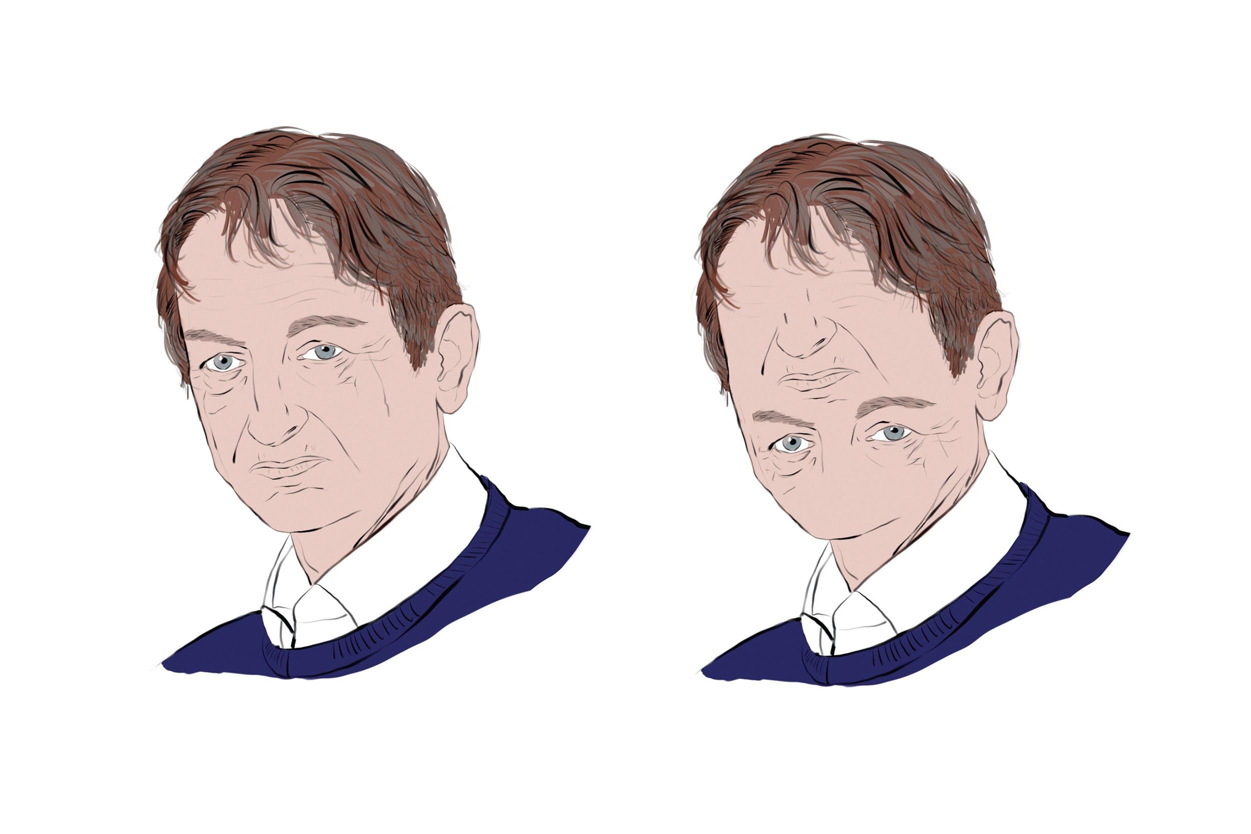
Capsule Networks

Slide 23
Capsule Networks

